Slide 1

Machine Learning with Python
Ensemble Method (Bagging and Boosting)
Arghya Ray

Slide 2
Ensemble Methods: Bagging and Boosting

Slide 3
Rationale
The ensemble classifier is likely to have a lower error rate (boosting)
The variance of the ensemble classifier will be lower than had we used certain unstable classification models (such as decision trees and neural nets) that have high variability (bagging and boosting)
Suppose we have an ensemble of binary classifiers each with error rate 0.20. If the individual classifiers agree the error rate will be the same as for the individual classifiers, the ensemble classifier will make an error only when the majority of individual classifiers make an error

Slide 4
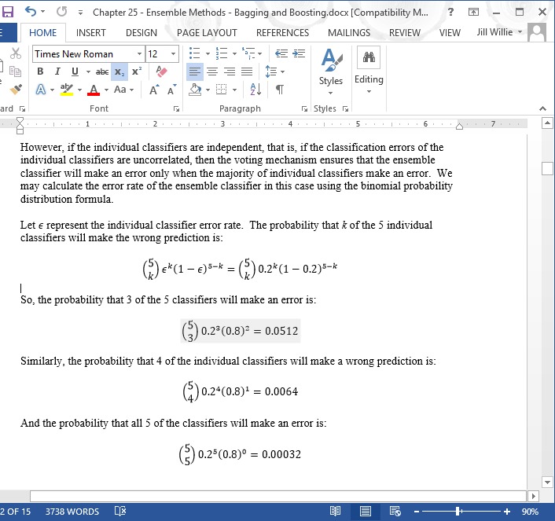
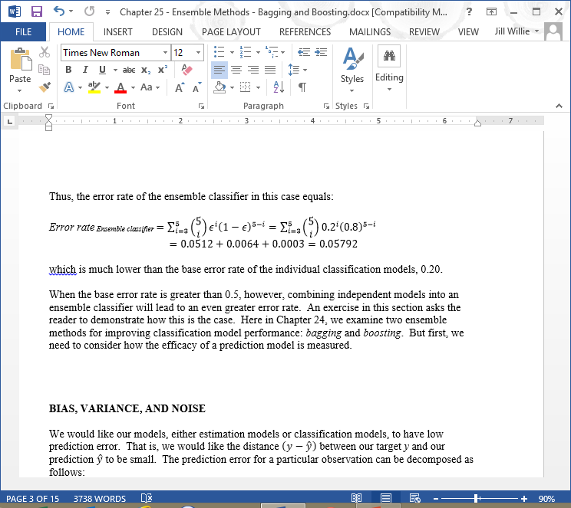
Rationale (cont.)
Let ε represent the individual classifier error rate. The probability that k of the 5 individual classifiers will make the same wrong prediction is:
And the probability that all 5 of the classifiers will make an error is:
And the error rate for the ensemble is:

Slide 5

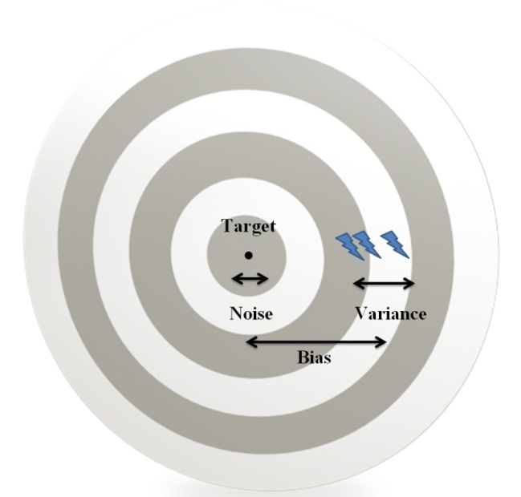
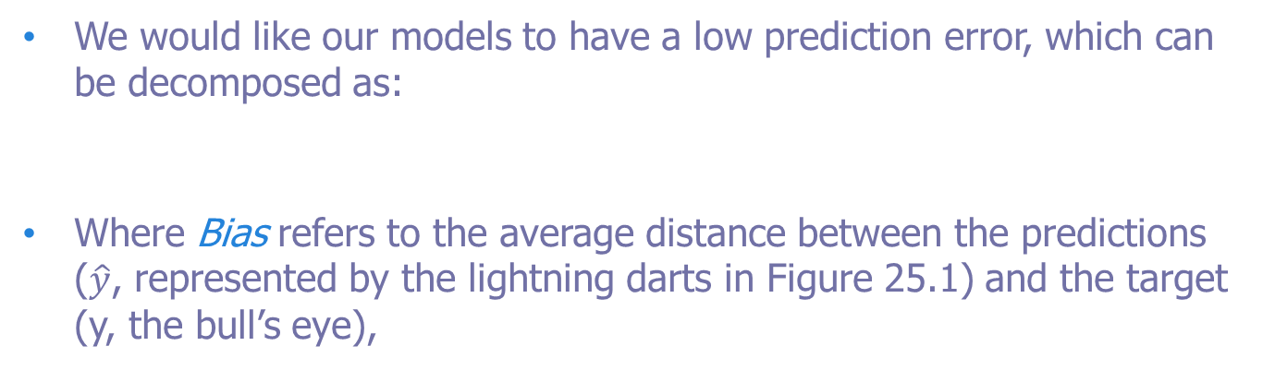
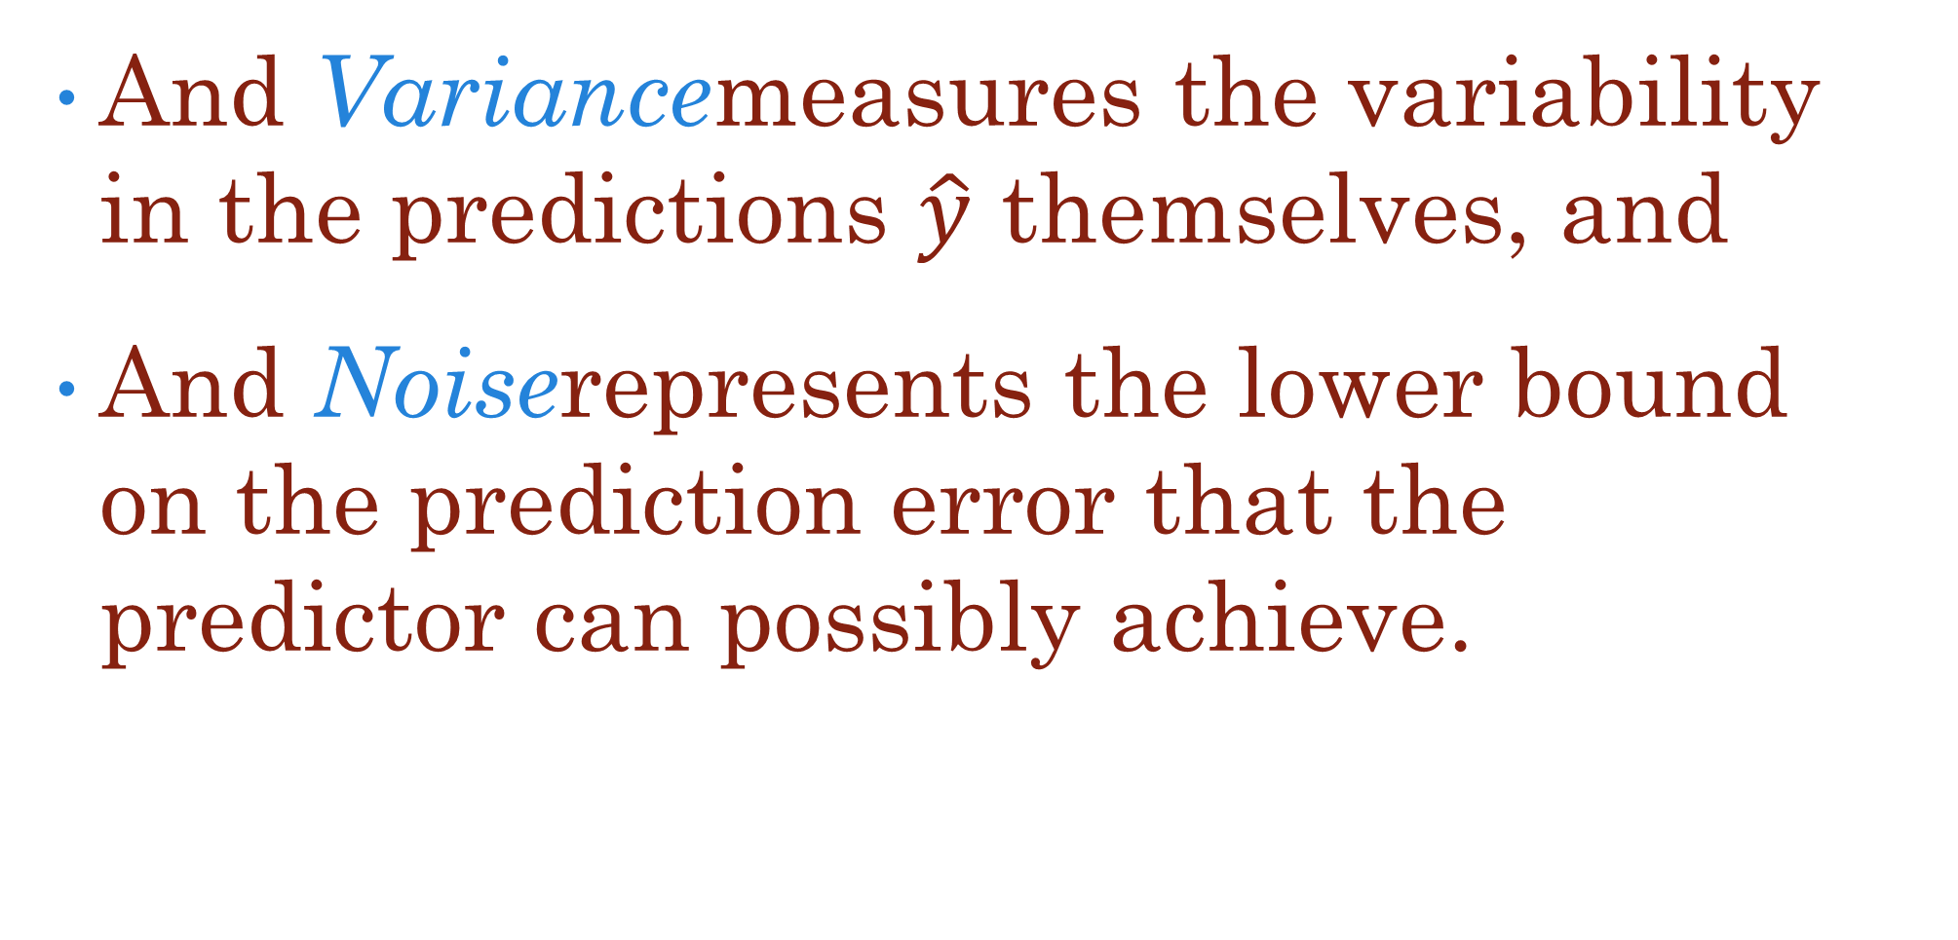
Bias, Variance, and Noise
We would like our models to have a low prediction error, which can be decomposed as:
Where Biasrefers to the average distance between the predictions ($\hat{y}$, represented by the lightning darts in Figure 25.1) and the target (y, the bull’s eye),
And Variancemeasures the variability in the predictions $\hat{y}$ themselves, and
And Noiserepresents the lower bound on the prediction error that the predictor can possibly achieve.

Slide 6
Bias, Variance, and Noise (cont.)
To reduce prediction error we need to reduce the bias, variance or noise. Unfortunately noise is an intrinsic characteristic of the prediction problem and can not be reduced.
Bagging can reduce the variance of the classifier models
Boosting can reduce both bias and variance and thus offers a way to short-circuit the bias-variance tradeoff, where efforts to reduce bias necessarily increase the variance and vice-versa.

Slide 7
When to Apply Bagging
“Some classification and regression methods are unstable in the sense that small perturbations in their training sets or in construction may result in large changes in the constructed predictor.” (Breiman 1998)
Classification Algorithm | Stable or Unstable
Classification and Regression Trees | Unstable
C4.5 | Unstable
Neural Networks | Unstable
k-Nearest Neighbor | Stable
Discriminant Analysis | Stable
Naïve Bayes | Stable

Slide 8
When to Apply Bagging (cont.)
Bagging works best with unstable models where there is room for improvement in reducing variability as it is a method for reducing variance.
Applying bagging to stable models can degrade their performance
Bagging works with bootstrap samples of the original data, each of which contains only about 63% of the data

Slide 9
Bagging
Bagging coined by Leo Breiman to refer to the following Boostrap Aggregating Algorithm:
Samples (with replacement) are repeatedly taken from the training data set, so that each record has an equal probability of being selected, and each sample is the same size as the original training data set. These are the bootstrap samples.
A classification or estimation model is trained on each bootstrap sample drawn in Step 1, and a prediction is recorded for each sample.
The bagging ensemble prediction is then defined to be the class with the most votes in Step 2 (for classification models) or the average of the predictions made in Step 2 (for estimation models).

Slide 10
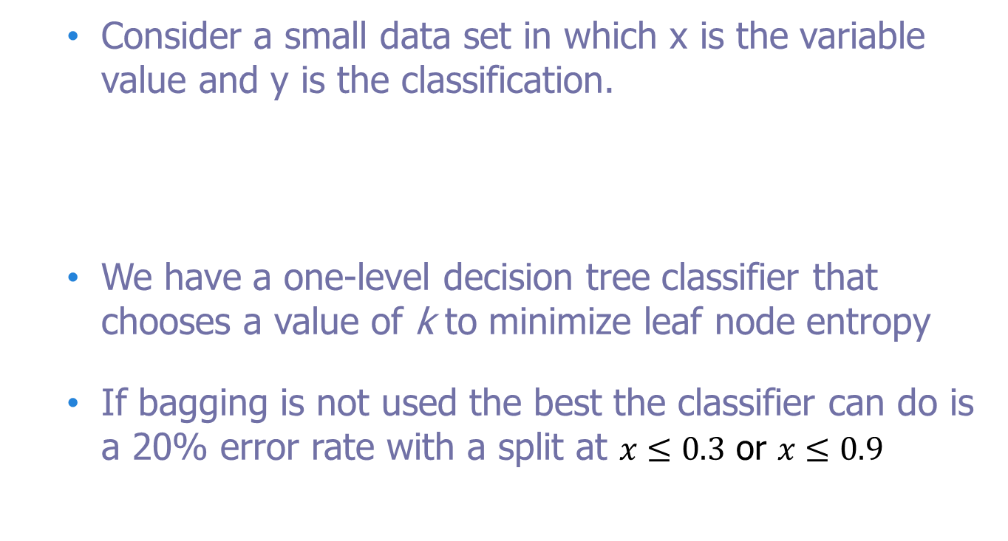
Bagging Example
Consider a small data set in which x is the variable value and y is the classification.
We have a one-level decision tree classifier that chooses a value of k to minimize leaf node entropy
If bagging is not used the best the classifier can do is a 20% error rate with a split at $x≤0.3$ or $x≤0.9$
x | 0.2 | 0.4 | 0.6 | 0.8 | 1
y | 1 | 0 | 0 | 0 | 1

Slide 11
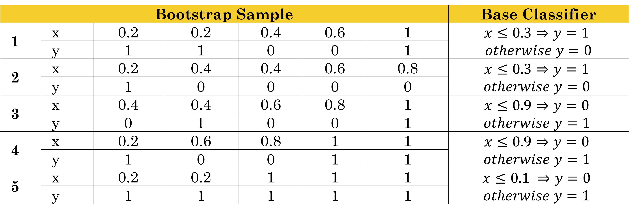
Bagging Example (cont.)
Step 1: Bootstrap samples are taken, and Step 2: one-level decision tree classifiers (base classifiers) are trained on each sample.
Bootstrap Sample |  |  |  |  |  |  | Base Classifier
1 | x | 0.2 | 0.2 | 0.4 | 0.6 | 1 | $$x≤0.3⇒y=1$$ $$otherwise y=0$$
 | y | 1 | 1 | 0 | 0 | 1
2 | x | 0.2 | 0.4 | 0.4 | 0.6 | 0.8 | $$x≤0.3⇒y=1$$ $$otherwise y=0$$
 | y | 1 | 0 | 0 | 0 | 0
3 | x | 0.4 | 0.4 | 0.6 | 0.8 | 1 | $$x≤0.9⇒y=0$$ $$otherwise y=1$$
 | y | 0 | 1 | 0 | 0 | 1
4 | x | 0.2 | 0.6 | 0.8 | 1 | 1 | $$x≤0.9⇒y=0$$ $$otherwise y=1$$
 | y | 1 | 0 | 0 | 1 | 1
5 | x | 0.2 | 0.2 | 1 | 1 | 1 | $$x≤0.1 ⇒y=0$$ $$otherwise y=1$$
 | y | 1 | 1 | 1 | 1 | 1

Slide 12
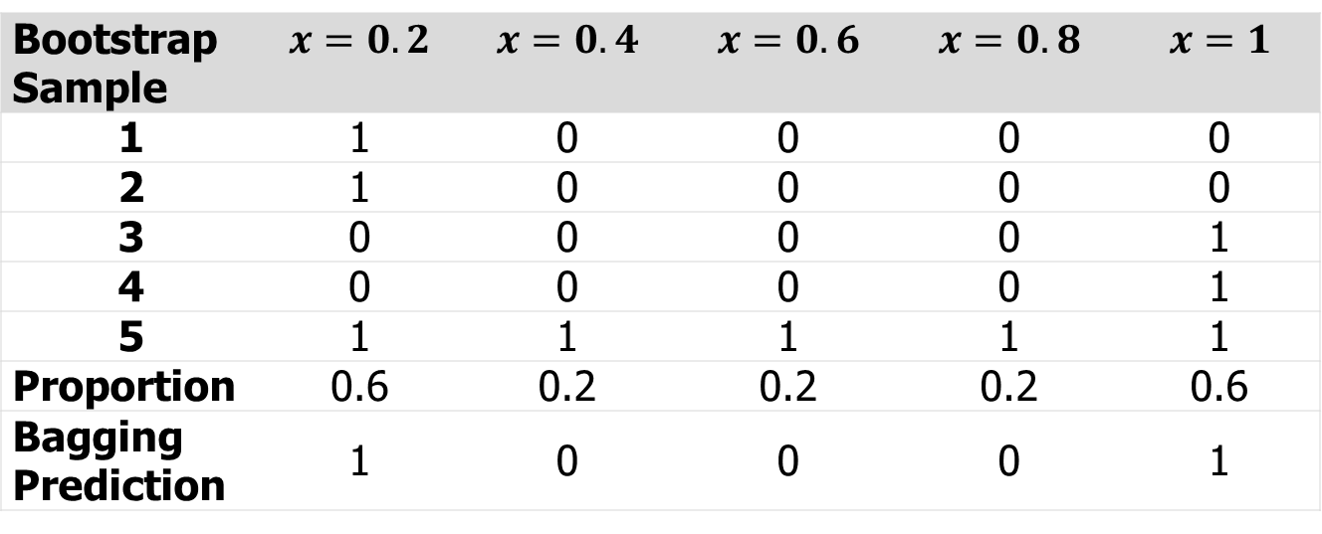
Bagging Example (cont.)
Step 3. For each record tally votes and select the majority class. Since we have 0/1 classifier the majority is the proportion of 1’s. If the proportion is less than 0.5 then the bagging prediction is 0, otherwise 1.
Bootstrap Sample | $$x=0.2$$ | $$x=0.4$$ | $$x=0.6$$ | $$x=0.8$$ | $$x=1$$
1 | 1 | 0 | 0 | 0 | 0
2 | 1 | 0 | 0 | 0 | 0
3 | 0 | 0 | 0 | 0 | 1
4 | 0 | 0 | 0 | 0 | 1
5 | 1 | 1 | 1 | 1 | 1
Proportion | 0.6 | 0.2 | 0.2 | 0.2 | 0.6
Bagging Prediction | 1 | 0 | 0 | 0 | 1

Slide 13
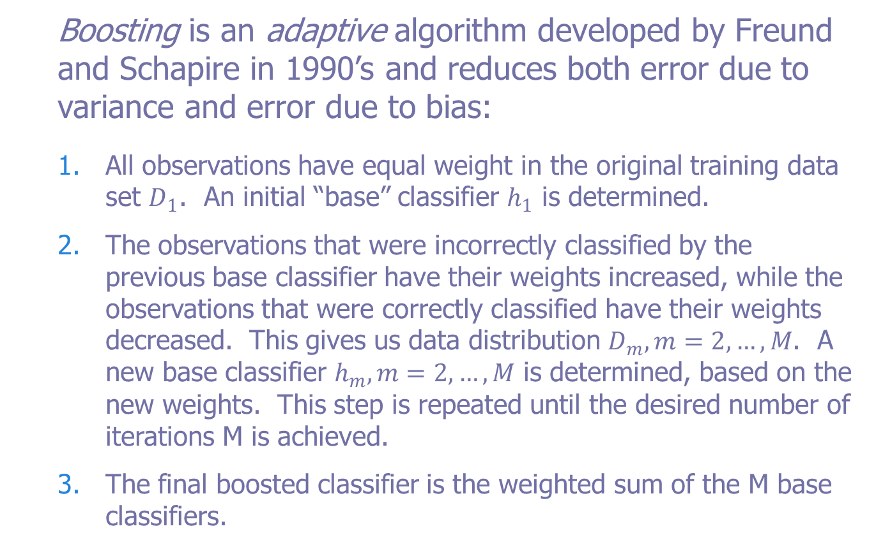
Boosting
Boosting is an adaptive algorithm developed by Freund and Schapire in 1990’s and reduces both error due to variance and error due to bias:
All observations have equal weight in the original training data set $D_{1}$. An initial “base” classifier $h_{1}$ is determined.
The observations that were incorrectly classified by the previous base classifier have their weights increased, while the observations that were correctly classified have their weights decreased. This gives us data distribution $D_{m}, m=2,…,M$. A new base classifier $h_{m}, m=2, …, M$ is determined, based on the new weights. This step is repeated until the desired number of iterations M is achieved.
The final boosted classifier is the weighted sum of the M base classifiers.

Slide 14
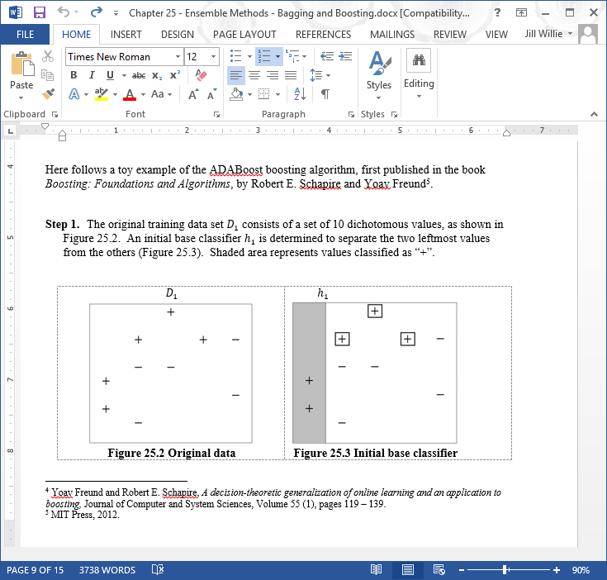
Boosting Step 1:
Training data D₁ consists of 10 dichotomous values as shown below. An initial base classifier h₁ is determined to separate the two leftmost values. Shaded area represents values classified as “+”. Boxed values are those incorrectly classified.

Slide 15
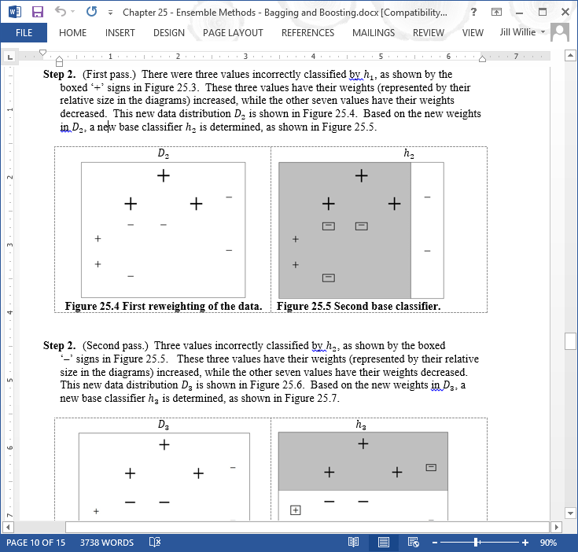
Boosting Step 2 (first pass):
3 values incorrectly classified by h₁ have weights (represented by relative size in diagrams) increased while other 7 have weights decreased. Based on the new weights a new classifier h₂ is determined

Slide 16
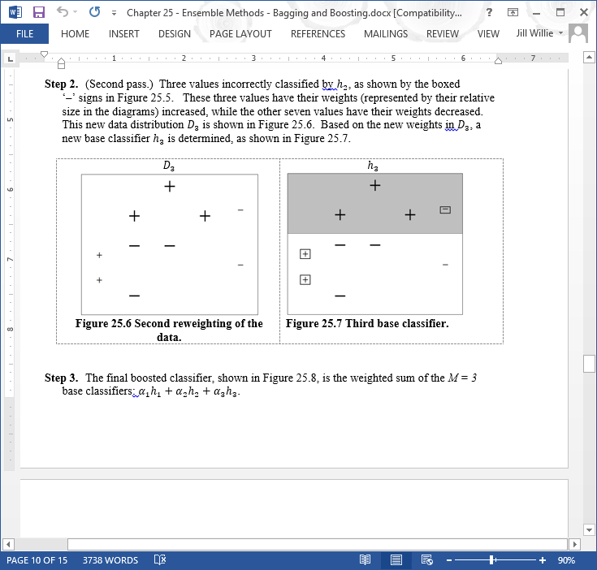
Boosting Step 2 (second pass):
3 values incorrectly classified by h₂ have weights increased while other 7 have weights decreased. Based on the new weights a new classifier h₃ is determined

Slide 17
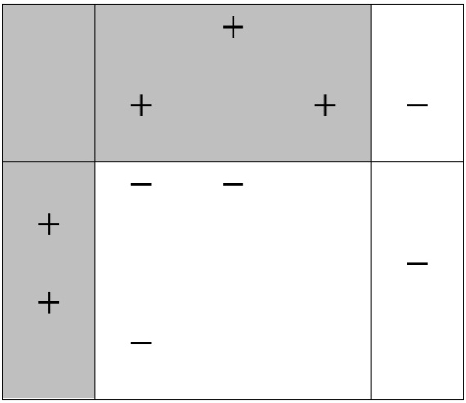
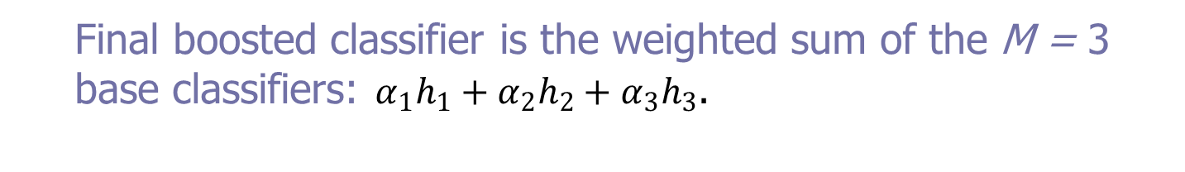
Boosting Step 3:
Final boosted classifier is the weighted sum of the M = 3 base classifiers: $α_{1}h_{1}+α_{2}h_{2}+α_{3}h_{3}$.
Weights assigned each classifier proportional to accuracy of classifier
Boosting performs best when base classifiers area unstable
Boosting can increase the variance when the base classifier is stable

Slide 18
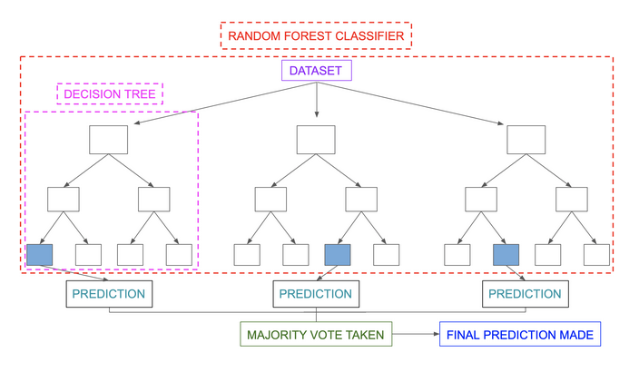
Random Forest
Good Article: https://www.section.io/engineering-education/introduction-to-random-forest-in-machine-learning/
https://towardsdatascience.com/random-forest-3a55c3aca46d

Slide 19
Classification in random forests:
Classification in random forests employs an ensemble methodology to attain the outcome. The training data is fed to train various decision trees. This dataset consists of observations and features that will be selected randomly during the splitting of nodes.
A rain forest system relies on various decision trees. Every decision tree consists of decision nodes, leaf nodes, and a root node. The leaf node of each tree is the final output produced by that specific decision tree. The selection of the final output follows the majority-voting system. In this case, the output chosen by the majority of the decision trees becomes the final output of the rain forest system.
Regression in random forests
Regression is the other task performed by a random forest algorithm. A random forest regression follows the concept of simple regression. Values of dependent (features) and independent variables are passed in the random forest model.
In a random forest regression, each tree produces a specific prediction. The mean prediction of the individual trees is the output of the regression. This is contrary to random forest classification, whose output is determined by the mode of the decision trees’ class.

Slide 20
The content of the slides are prepared from different textbooks.
References:
Data Mining and Predictive Analytics, By Daniel T. Larose. Copyright 2015 John Wiley & Sons, Inc.
Predictive Analytics for Dummies, By Anasse Bari, Mohamed Chaouchi, & Tommy Jung, Copyright 2016, John Wiley & Sons, Inc.
Introduction to Data Mining with Case Studies, By G.K. Gupta. Copyright 2014 by PHI Learning Private Limited.

Slide 21

Thank you..

